Slide 1
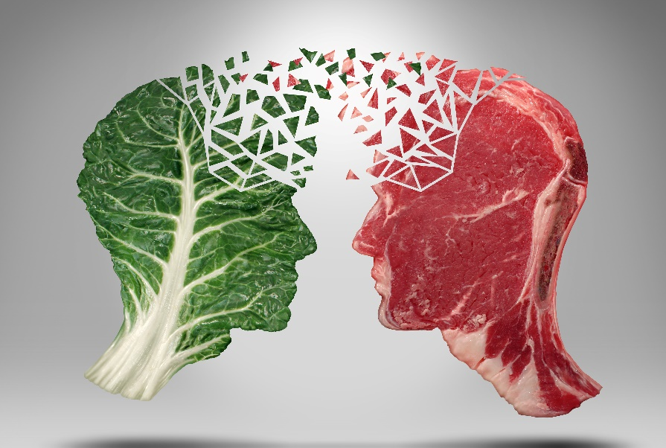
FMCG GURUS: Top Trend: Plant-Life Explored
March 2020

Slide 2
Plant-Life Explored
Alternative Proteins
Botanicals
Taste & Texture
Notes:
Images

Slide 3
Overview of Report
This presentation examines the trend Plant Life
What is it?
Trend evolution?
This presentation examines the topic of Plant-Life, one of FMCG Gurus Top Ten Trends for 2020. Within this trend there are three sub-trends: Alternative Proteins, Botanicals and Taste and Textures.
This trend examines how consumers are turning to plant-based food and drink products for health and sustainability, a key reason for the rising number of consumers who classify themselves as flexitarians, vegetarians and vegans. The trend examines how consumers have favorable perceptions towards plants and botanicals but how taste can be something of a barrier to these changing consumer behaviors.
Plant-based alternatives are not a new trend. Indeed, products such as Quorn have been round for decades and have been a popular option amongst niche audiences such as vegetarians. The same is true of other plant-based ingredients such as lentil and soy.
However, in recent years these ingredients have become more popular amongst the masses. This is being driven by consumers changing their diets to lead healthier and more sustainable lifestyles and also associating plant-based ingredients with being natural and having an array of health benefits.
Why is it important?
Barriers to the trend
Consumers are concerned about the state of the environment and believe that damage done is potentially irreversible. At the same time, they are also becoming conscious about their long-term health and can often believe that the issues of health and sustainability are interlinked.
Whilst historically consumers have placed greater responsibility on protecting the environment on big business rather than the individual, they are now taking a more collective approach to the issue. This means that consumers are changing their diets to act in a more healthy and sustainable manner, driving demand for plant-based alternatives.
When it comes to plant-based food and drink products, the main barrier that the industry faces is the issue of taste.
Despite consumers wanting to cut down on their meat and dairy, they can often find it difficult to do so, with indulgence being a key reason for this. Additionally, many consumers can believe that plant-based products are bland and boring, aligning with the wider barrier facing the health and wellness market that some consumers feel the least healthy food and drink is the tastiest. Additionally, the premium price tag associated with such products is also a barrier at a time of increased price sensitivity.
Notes:
Images

Slide 4
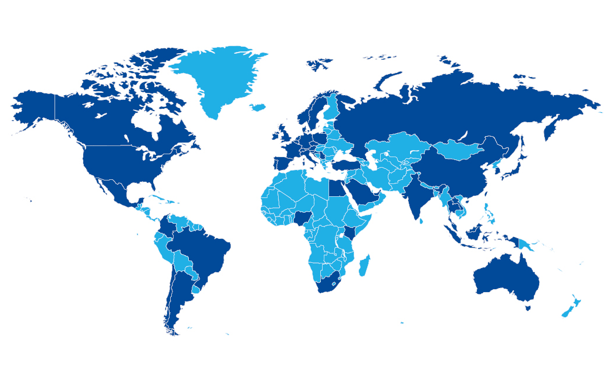
Coverage
This report is based on 4 survey series covering over 100,000 consumers in 2019
Meat & Plant Protein | Active Nutrition | Sustainability | Sleep & Stress Management
Global coverage
Europe
Asia-Pacific
Austria
Croatia
Denmark
France
Germany
Italy
Netherlands
Norway
Poland
Serbia
Slovenia
Spain
Sweden
Turkey
UK
Australia
China
Indonesia
Japan
Malaysia
South Korea
Thailand
Vietnam
Africa/Middle East
Nigeria
Saudi Arabia
South Africa
UAE
South America
North America
Argentina
Brazil
Chile
Canada
Mexico
USA
Notes:
Images

Slide 5
Overview of the sub-trends
This trend comprises of three sub-trends
Alternative Proteins
Consumers are taking a greater interest in alternative protein sources than ever before. This is something that is undoubtedly being helped by mainstream interest in protein in general continuing to grow. Nevertheless, plant-based alternatives are becoming more popular as consumers associate such products with being healthier and more sustainable. This is driving demand for plant-based ingredients in better-for-you categories such as healthier snack products, as well as everyday alternatives for consumers who are looking to cut down on their intake of meat and dairy. The desire for products that contain only real and authentic ingredients that are 100% natural is also a key reason for interest in plant-based products.
Botanicals
Consumer interest in botanical ingredients is also on the rise, with consumers seeking out products that contain these ingredients. Similar to interest in plant-based ingredients, the appeal of botanicals can be linked to consumers demonstrating a considerable level of trust towards such ingredients and associations with being healthier and more sustainable. The appeal of botanical ingredients is also growing at a time when consumers are struggling with the frantic nature of modern day life and are struggling to switch off and relax and unwind. At a time when consumers recognize this can have a significant impact on their health, they are seeking out natural solutions to address this.
Taste and Texture
Although consumers want to lead a healthier and more sustainable lifestyle, it also needs to be remembered that they also have more me-centric need states that they prioritize. Taste and indulgence are a prime example of this and something that consumers are unwilling to compromise on. Whilst consumers have favorable perceptions of plant-based products, they can also be concerned about the taste and texture of such products. This is a challenge for the industry as consumers do not want to compromise on moments of indulgence, even when they are seeking out products that they associate with being better-for-you and offering nutritional value.
Notes:
Images

Slide 6
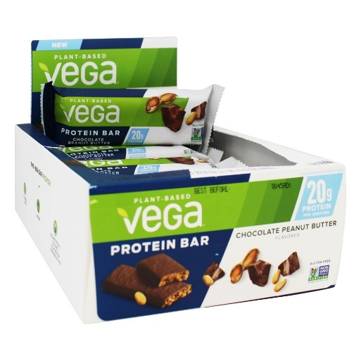
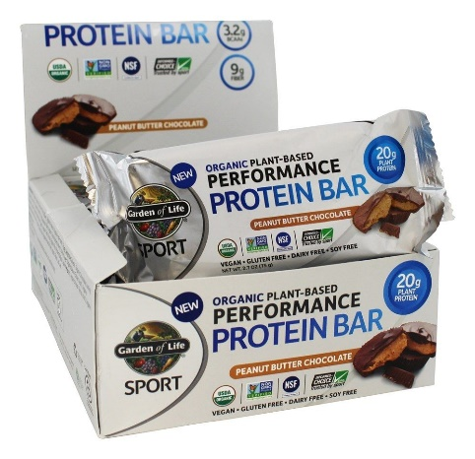
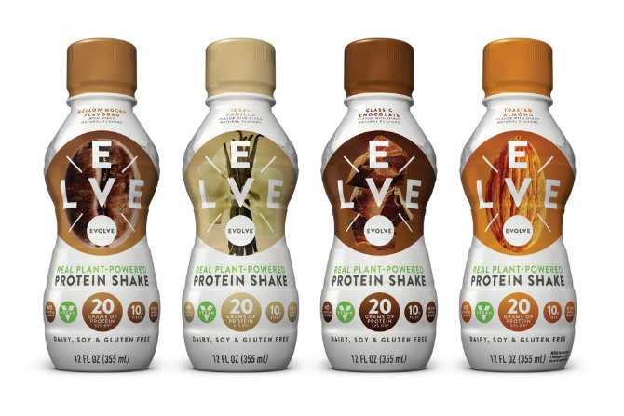
Global consumers believe plants to be the most appealing source of protein
Such products will appeal to consumers seeking out better-for-you products
How appealing are the following types of protein sources?
Respondents who say appealing or very appealing
Global
FMCG Gurus asked health conscious consumers who are taking a proactive approach to wellbeing across the globe, how appealing different protein sources are. The research shows that overall, plant-based protein is the most appealing form.
This is because such products are not just associated with an array of health benefits but with also being natural and more environmentally-friendly. Moreover, the source aligns with contemporary dieting patterns and reduction of animal-based produce.
Plant-based protein claims will be of high appeal to consumers in impulse categories, as they looking to substitute traditional snack products such as chocolate and drinks such as carbonates for high protein/low sugar alternatives that they deem to be better-for-you.
Notes:
Images

Slide 7
Consumers are looking to reduce meat from their diets for health and sustainability purposes
These two issues are often interlinked
FMCG Gurus research shows that across the globe, 75% say that they eat meat on a regular basis, meaning that one in four do not.
This highlights why the number of people who classify themselves as vegan, vegetarian or a flexitarian is on the rise.
When it comes to not eating meat on a regular basis, the two main reasons for not doing so is health and sustainability reasons. These two issues are often interlinked, with consumers feeling that damage done to the environment as a result of issues such as global warming is something that is having a direct impact on health.
As such, consumers are making conscious efforts to adjust their diets in order to lead what they believe to be a better-for-you lifestyle. This is something that needs to be taken into consideration when it comes to plant-based diets, with consumers seeing it as a form of self expression and elitism.
The research shows that the demand for plant-based food and drink products is not just something that is restricted to performance-based nutrition products and instead, a significant proportion of consumers want products for their everyday diets.
Why do you not eat meat on a regular basis?
Respondents who do not eat meat regularly
Top five answers
Notes:
Images

Slide 8
Three in ten consumers across the globe say that they eat meat-substitute products on a regular basis
North American consumers are the least likely to turn to meat-substitutes
Do you eat meat substitutes/replacements?
Global
Africa
Asia-Pacific
Europe
North America
South America
FMCG Gurus research shows that three in ten consumers across the globe say that they eat meat substitute products. Consumers in Africa are the most likely to say this whilst consumers in North America are the least likely. This is despite meat capita per consumption in Africa being lower in many developed economies across the globe.
When it comes to meat substitute products, 70% of consumers say that it is important that such products are 100% naturally formulated. This is because consumers want to avoid products that they deem to be detrimental to their health and instead only want real and authentic ingredients. This is something that is driving demand for plant-based meat products.
It must be remembered that the concept of meat substitutes and plant-based alternatives are not a new concept. However, greater focus on health and sustainability as a form of self-expression is something that is driving demand for such products. As consumers continue to become more concerned about ethical, environmental and health issues, the reality is that such products will continue to grow in popularity.
Notes:
Images

Slide 9
Meat-reduction and switching to plant-based diets is also linked to the topic of sustainability
Consumers can feel that health and sustainability are interlinked
Have you changed your diet in the last two years in order to lead a more environmentally friendly lifestyle?
Global
Africa
Asia-Pacific
Europe
North America
South America
What changes have you made?
Respondents who have changed their diets to lead a more environmentally-friendly lifestyle
 | Global | Africa | Asia-Pacific | Europe | North America | South America
Reduced/eliminated eating meat | 33% | 29% | 33% | 35% | 31% | 29%
Reduced/eliminated eating/drinking dairy | 42% | 41% | 38% | 48% | 37% | 38%
Reduced/eliminated eating fish | 14% | 15% | 13% | 13% | 16% | 15%
Followed a vegetarian diet | 22% | 27% | 22% | 19% | 28% | 21%
Followed a vegan diet | 10% | 14% | 10% | 10% | 10% | 10%
Something already touched upon, the issue of sustainability is a key reason why consumers are switching to plant-based diets. FMCG Gurus research shows that in the last two years, more than four in ten consumers have made changes to their dietary habits in order to lead a more environmentally-friendly lifestyle. When it comes to doing this, common strategies being followed are to reduce meat and dairy intake and switch to vegetarian and vegan diet plans.
This means that when it comes to plant-based products, it is jus as important to promote the sustainability benefits of such products as well as the health benefits (especially as consumers often feel that these two issues are interlinked).
Notes:
Images

Slide 10
The desire to try and switch off from the pressures of modern life is raising the appeal of botanical products
Botanicals are associated with aiding sleeping patterns
As well as taking an interest in plant-based protein products, consumer are also taking an interest in botanicals.
Similar to protein sources, this is because consumers tend to be aware of such ingredients and trust them. Moreover they deem themselves to be natural and something that can be found in everyday products. Finally, botanicals are also associated with aiding relaxation.
The latter point is something that is especially important at a time when consumers are struggling with feelings of stress and disrupted sleeping patterns. Cognitive health issues are being brought about by a number of factors such as consumers trying to cram as many activities into the day as possible and struggling to switch off and unwind and additionally, consumers having a myriad of worries that prevent them from relaxing and sleeping.
This is something that is driving appeal of botanicals as a solution for these issues. Typically when it comes to health and wellness issues, consumers demonstrate an attitude/behavior gap and are not actively seeking out products that contain botanicals – something the industry needs to address.
Do you associate any of the following ingredients with improving sleeping patterns?
Global – Top ten answers
Only 21% of global consumers say that they are currently using botanicals to help improve their sleeping patterns
Notes:
Images

Slide 11
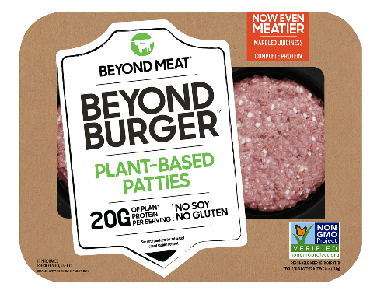
Some consumers believe that alternative proteins are less tasty than animal-based protein
Consumers can be concerned about taste and texture
Would you say that plant-based protein tastes…
Global – Top ten answers
Whilst consumers are demonstrating a favorable perception of plant-based products, it is important not to over-estimate demand. One of the key reasons for this is the issue of taste and indulgence. After all, irrespective of the concerns that consumers may have when it comes to health and sustainability, these two issues continue to be the main motivations that drive eating habits.
FMCG Gurus research shows that four in ten global consumers believe that plant-based food and drink can be bland and boring. Additionally, 46% of global consumers believe that plant protein is inferior in taste compared to animal-based protein.
Taste and texture is something that can be an issue for consumers when it comes to plant-based products, something that can hinder enjoyment. This is something that the industry needs to address if the alternative protein market is to become truly mainstream.
42% of consumers admit that they can find plant-based food and drink products to be “bland and boring”
Notes:
Images

Slide 12
Taste is also a key reason why consumers do not turn to meat substitutes
Consumers can feel that alternative meat lacks taste
FMCG Gurus asked the seven out of ten consumers across the globe who do not turn to meat substitute products, why this is so. The research shows that the two main reasons for this is that people prefer real meat and that alternative meats lack taste. Again, this serves to highlight how consumers are conscious about the sensory element of alternative protein and meat products.
This further highlights how the industry needs to address issues relating to taste and texture if the alternative protein/meat substitute market is to become truly mainstream.
You state that you do not eat alternative meat substitutes/replacements. Why is this?
Respondents who do not eat meat substitutes/ replacements
Global
51% of global consumers admit that they would struggle to give up meat in the long-term
Notes:
Images

Slide 13
Conclusions
FMCG Gurus recommends the following when it comes to Plant-Life
Position plant-based diets as cool and fashionable
It must be remembered that many of the ingredients and products that are witnessing a surge in popularity as a result of plant-based diets are not new to the market and have been around for decades. The reason for the popularity is that consumers are changing their diets to act in a sustainable and healthier manner.
This is something that the industry needs to capitalize on by positioning plant-based products around forms of self-expression and elitism, positioning products as stylish and cool as opposed to simply being better-for-you.
Target better-for-you snacking occasions
Interest in alternative protein sources is something that is being driven by consumers turning to products high in protein because they are guilt-free and conveniently nutritious. This links to changing meal-time and snacking habits and consumers switching traditional impulse categories like chocolate for high protein/low sugar alternatives.
Plant-based ingredients appeal because they are natural and nutritious and as such, products need to be targeted at snacking occasions when consumers are seeking out better-for-you options.
Ensure products are not seen as compromise-free
Irrespective of attempts made by the food and drink industry to change perceptions over the decade, consumers can still feel that the healthiest food and drink is bland and boring and lacking in taste. Plant-based food and drink is no exception to this, whilst consumers can also be reluctant to cut down on products like meat and dairy for the same reason.
At a time when consumers are seeking out moments of indulgence and escapism daily, it is crucial that plant-based products are seen to be compromise-free when it comes to taste and texture.
Notes:
Images

